Slide 1

Heaven’s light is our guide”
Rajshahi University of Engineering & Technology
Department of Computer Science & Engineering
Data Communication
Course No. : CSE 3103
Chapter 7: Transmission Media
Prepared By : Julia Rahman

Slide 2
7 Transmission Media
A transmission medium can be broadly defined as anything that can carry information from a source to a destination.
For example, the transmission medium for two people having a dinner conversation is the air. The air can also be used to convey the message in a smoke signal or semaphore.
For a written message, the transmission medium might be a mail carrier, a truck, or an airplane.
Data is transmitted normally through electrical or electromagnetic signals.
Signals are transmitted in form of electromagnetic energy.
Transmission media are actually located below the physical layer and are directly controlled by the physical layer.

Slide 3
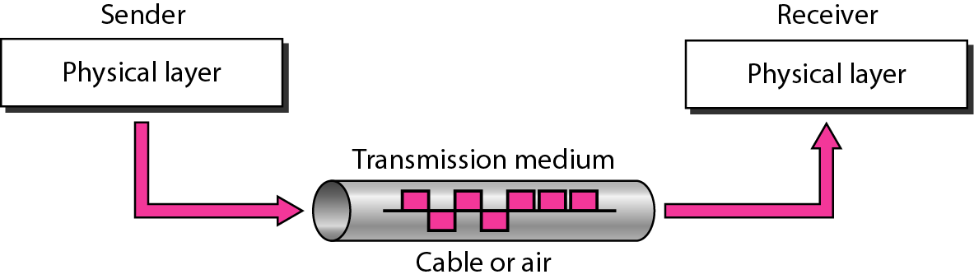
7 Transmission Media
Figure 7.1 Transmission medium and physical layer

Slide 4
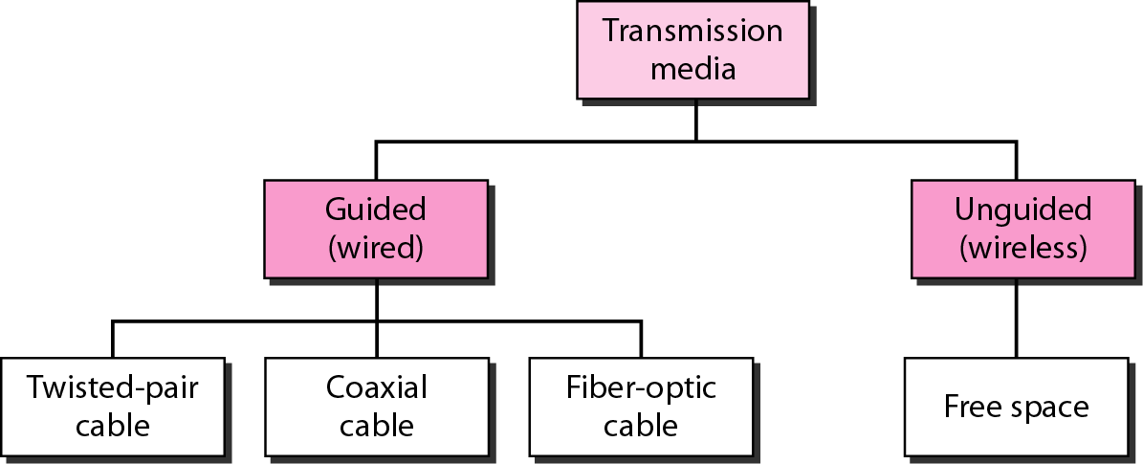
7 Transmission Media
Figure 7.2 Classes of transmission media

Slide 5
7-1 GUIDED MEDIA
Guided media, which are those that provide a conduit from one device to another, include twisted-pair cable, coaxial cable, and fiber-optic cable.
A signal traveling along any of these media is directed and contained by the physical limits of the medium.
Twisted-pair and coaxial cable use metallic (copper) conductors that accept and transport signals in the form of electric current.
Optical fiber is a cable that accepts and transports signals in the form of light.

Slide 6
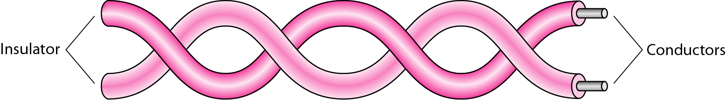
7-1 GUIDED MEDIA
Twisted-pair cable
A twisted pair consists of two conductors
Basically copper based
With its own plastic insulation, twisted together.

Slide 7
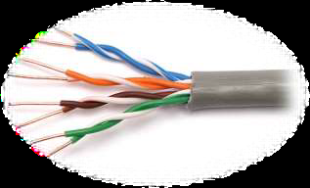
7-1 GUIDED MEDIA
Twisted-pair cable (cont.)
Provide protection against cross talk or interference(noise)
One wire use to carry signals to the receiver
Second wire used as a ground reference
For twisting, after receiving the signal remains same.
Therefore number of twists per unit length, determines the quality of cable.
The signal sent by the sender on one of the wires, interference (noise) and crosstalk may affect both wires and create unwanted signals.

Slide 8
7-1 GUIDED MEDIA
Twisted-pair cable (cont.)
If the two wires are parallel, the effect of these unwanted signals is not the same in both wires because they are at different locations relative to the noise or crosstalk sources (e,g., one is closer and the other is farther).
This results in a difference at the receiver.
By twisting the pairs, a balance is maintained.

Slide 9
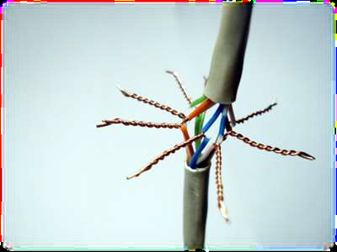
7-1 GUIDED MEDIA
Twisted-pair cable (cont.)
Advantages:
Cheap
Easy to work with
Disadvantages:
Low data rate
Short range
Application
Very common medium
Can be use in telephone network
Connection Within the buildings
For local area networks (LAN)

Slide 10
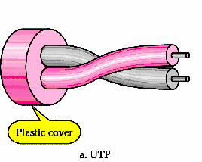
7-1 GUIDED MEDIA
Types of Twisted-pair cable
Unshielded Twisted Pair (UTP)
Shielded Twisted Pair (STP)
Unshielded Twisted Pair (UTP)
Pair of unshielded wires wound around each other
Easiest to install

Slide 11
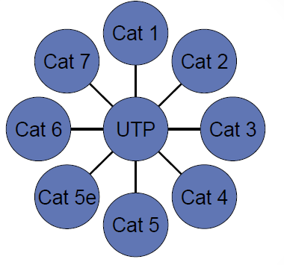
7-1 GUIDED MEDIA
Unshielded Twisted Pair (UTP) (cont.)
Applications:
Telephone subscribers connect to the central telephone office
DSL lines
LAN – 10Mbps or 100Mbps
UTP cable type:
Cat means category according to IEEE standards. IEEE is de jure standard

Slide 12
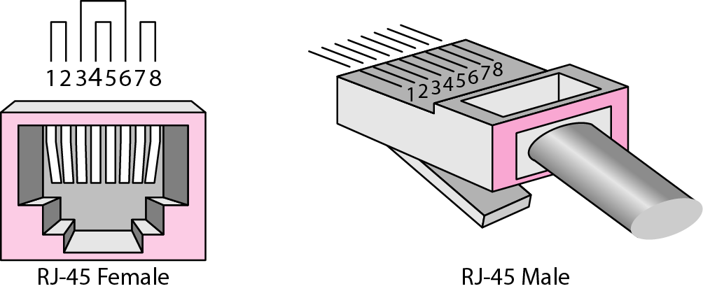
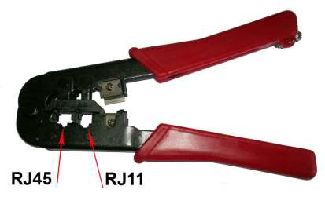
7-1 GUIDED MEDIA
Unshielded Twisted Pair (UTP) (cont.)
UTP connector and Tools:
RJ45 (RJ stands for registered jack) is a keyed connector, it means that it can be inserted in only one way
Crimper Tool

Slide 13
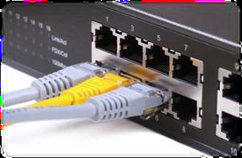
7-1 GUIDED MEDIA
Unshielded Twisted Pair (UTP) (cont.)
Advantages of UTP:
Affordable
Most compatible cabling
Major networking system
Disadvantages of UTP:
Suffers from external Electromagnetic interference

Slide 14
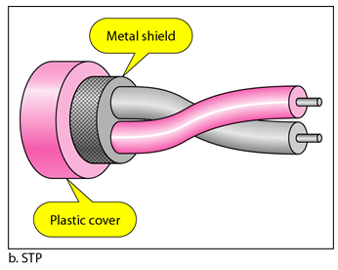
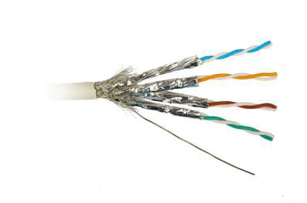
7-1 GUIDED MEDIA
Shielded Twisted Pair (STP)
Pair of wires wound around each other placed inside a protective foil wrap
Metal braid or sheath foil that reduces interference
Harder to handle (thick, heavy)

Slide 15
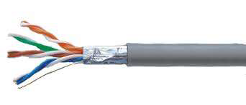
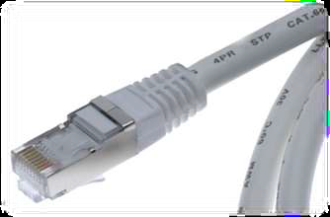
7-1 GUIDED MEDIA
Shielded Twisted Pair (STP) (cont.)
Applications:
STP is used in IBM token ring networks.
Higher transmission rates over longer distances.
Advantages of UTP:
Shielded
Faster than UTP
Disadvantages of UTP:
More expensive than UTP
High attenuation rate

Slide 16
7-1 GUIDED MEDIA
Co-axial Cable
Co-axial cable carries signal of higher frequency ranges than twisted pair cable
Coax has a central core conductor of solid or stranded wire, enclosed in an insulating sheath, which is, in turn, encased in an outer conductor of metal foil, braid, or a combination of the two.
Outer conductor serves as a shield against noise and a second conductor
This outer conductor is also enclosed in an insulating sheath, and the whole cable is protected by a plastic cover

Slide 17
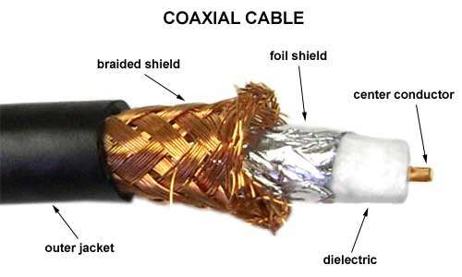
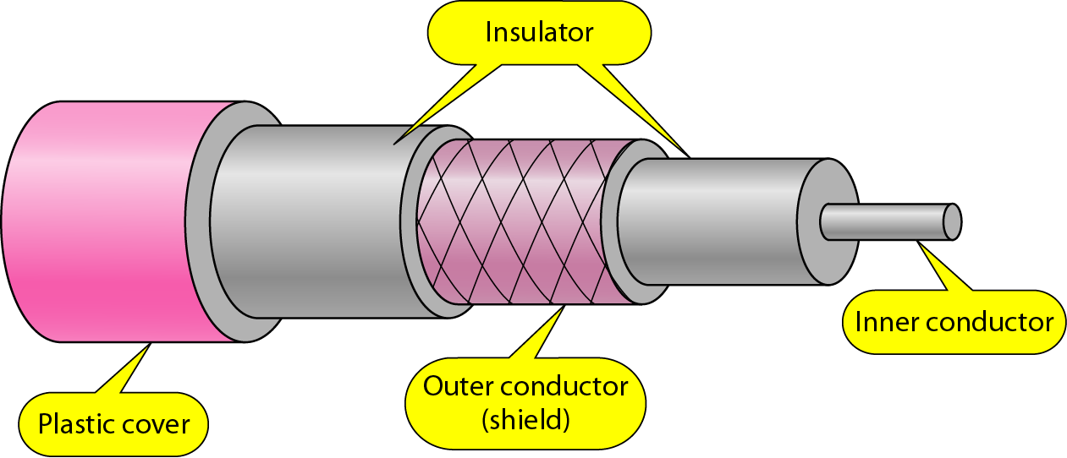
7-1 GUIDED MEDIA
Co-axial Cable (cont.)

Slide 18
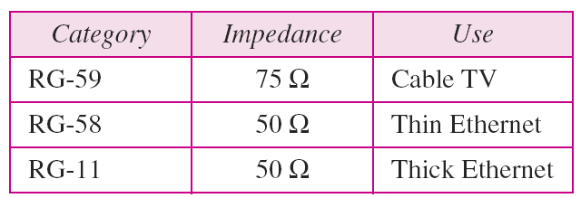
7-1 GUIDED MEDIA
Co-axial Cable (cont.)
Coaxial Cable Standards:
Coaxial cables are categorized by their radio government (RG) ratings.
Each RG number denotes a unique set of physical specifications, including the wire gauge of the inner conductor, the thickness and type of the inner insulator, the construction of the shield, and the size and type of the outer casing.
Table 7.2 Categories of coaxial cables

Slide 19
7-1 GUIDED MEDIA
Co-axial Cable (cont.)
Coaxial Cable Connectors:
To connect coaxial cable to devices we need coaxial connectors - BNC (Bayone Neil Concelman) Connectors
BNC Connector is used at the end of the cable to a device
Example: TV set conenction
BNC T connector used to Ethernet networks to branch out connection to computer or other devices
BNC terminator is used at the end of the cable to prevent the reflection of the signal

Slide 20
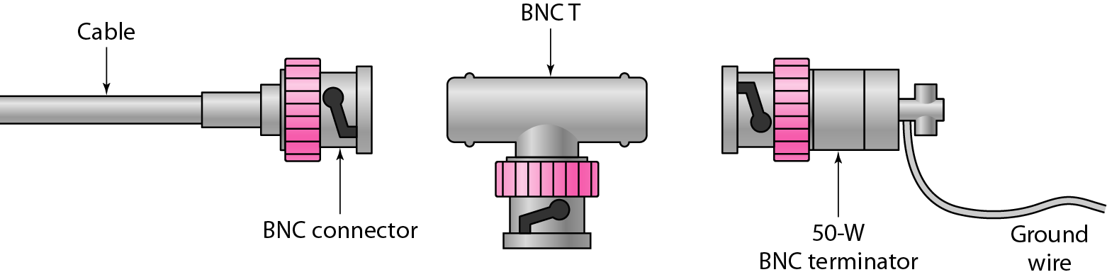
7-1 GUIDED MEDIA
Co-axial Cable (cont.)
Coaxial Cable Connectors (cont.):
Figure 7.8 BNC connectors

Slide 21
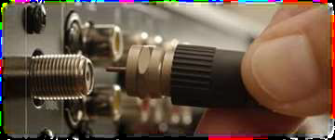
7-1 GUIDED MEDIA
Co-axial Cable (cont.)
Application:
Most versatile medium
Analog telephone networks – a single coaxial network could carry 10,000 voice signals
Cable TV networks
Short distance computer systems links
Ethernet LANs

Slide 22
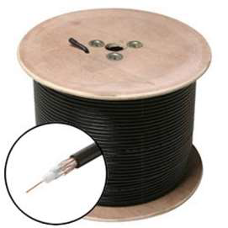
7-1 GUIDED MEDIA
Co-axial Cable (cont.)
Advantages:
Easy to wire
Easy to expand
Moderate level of Electro Magnetic Interference
Disadvantages:
Single cable failure can take down an entire network
Cost of installation of a coaxial cable is high due to its thickness and stiffness
Cost of maintenance is also high

Slide 23
7-1 GUIDED MEDIA
Fiber-Optic Cable
A fiber-optic cable is made of glass or plastic and transmits signals in the form of light.
To understand optical fiber, we first need to explore several aspects of the nature of light.
Nature of light:
Light travels in a straight line
If light goes from one substance to another then the ray of light changes direction
Ray of light changes direction when goes from more dense to a less dense substance

Slide 24
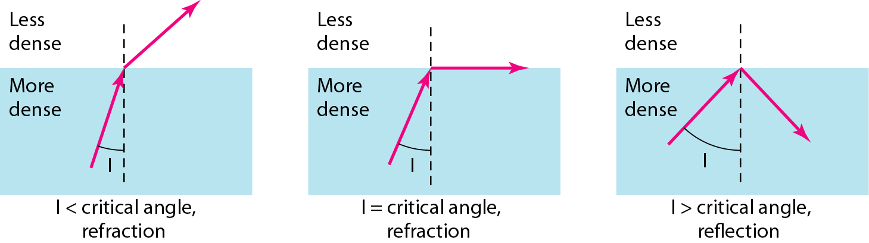
7-1 GUIDED MEDIA
Fiber-Optic Cable (cont.)
Bending of light ray:
Angle of Incidence (I): the angle the ray makes with the line perpendicular to the interface between the two substances
Critical Angle: the angle of incidence which provides an angle of refraction of 90-degrees.
Figure 7.10 Fiber optics: Bending of light ray

Slide 25
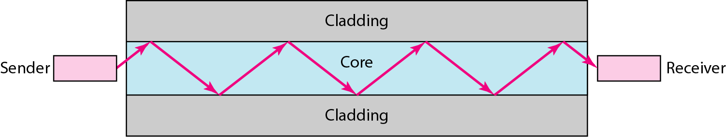
7-1 GUIDED MEDIA
Fiber-Optic Cable (cont.)
Uses reflection to guide light through a channel
Core is of glass or plastic surrounded by Cladding
Cladding is of less dense glass or plastic
An optical fiber cable has a cylindrical shape and consists of three concentric sections:
the core, the cladding, and the jacket(outer part of the cable).

Slide 26
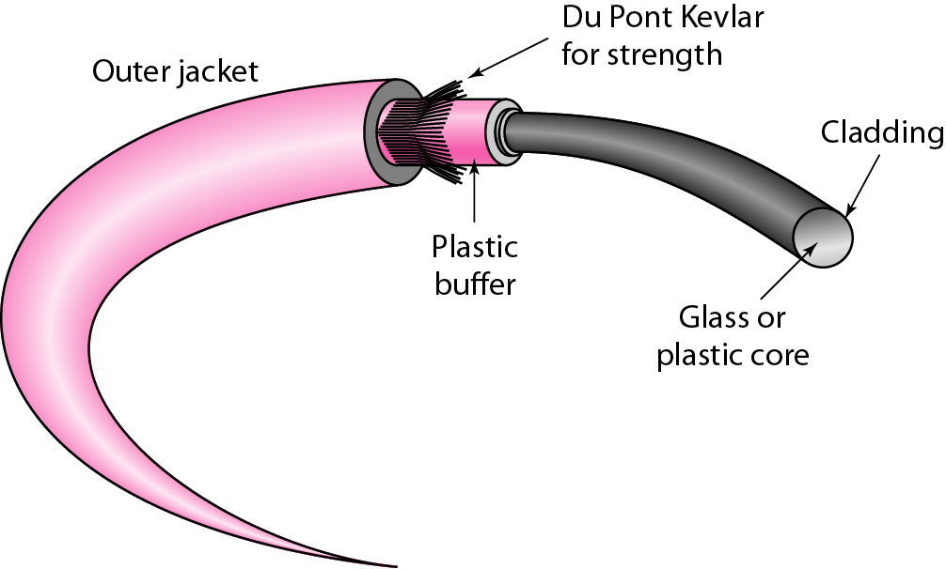
7-1 GUIDED MEDIA
Fiber-Optic Cable (cont.)
Figure 7.14 Fiber construction

Slide 27
7-1 GUIDED MEDIA
Fiber-Optic Cable Connectors
There are three types of connectors for fiber-optic cables
Subscriber channel (SC) connector is used for cable TV. It uses a push/pull locking system.
Straight-tip (ST) connector is used for connecting cable to networking devices. It uses a bayonet locking system and is more reliable than SC.
MT-RJ is a connector that is the same size as RJ45.

Slide 28
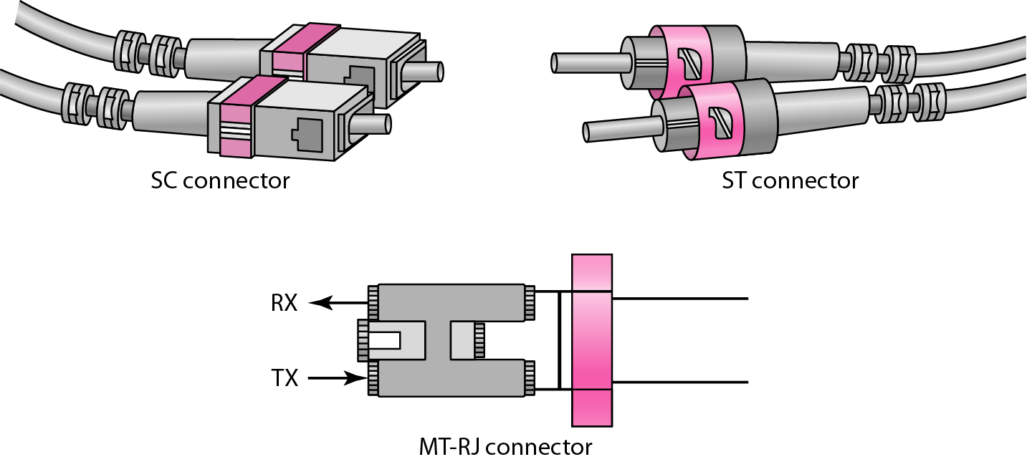
7-1 GUIDED MEDIA
Fiber-Optic Cable Connectors (cont.)
Figure 7.15 Fiber-optic cable connectors

Slide 29
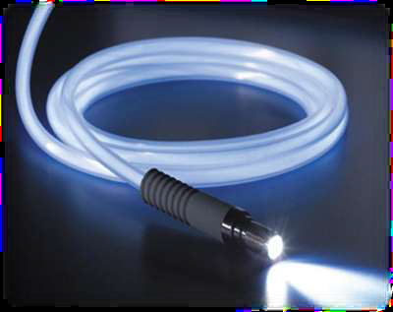
7-1 GUIDED MEDIA
Fiber-Optic Cable (cont.)
Application:
Telecommunications
In backbone networks because its wide bandwidth is cost-effective.
Local Area Networks
Cable TV
CCTV
SONET network
Medical Education

Slide 30
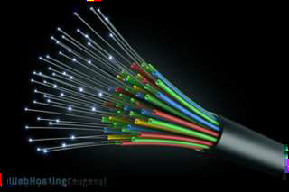
7-1 GUIDED MEDIA
Fiber-Optic Cable (cont.)
Advantages:
Greater capacity or Higher bandwidth; Example: Data rates at 100 Gbps
Smaller size & light weight
Lower signal attenuation
Electromagnetic isolation
Immunity to electromagnetic interference – Electromagnetic noise cannot affect
More resistance to corrosive materials
Greater repeater spacing facility - Example: After every 10s of km at least

Slide 31
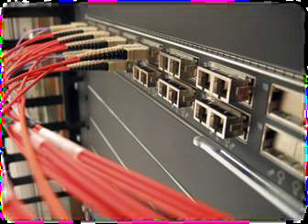
7-1 GUIDED MEDIA
Fiber-Optic Cable (cont.)
Disadvantages:
Installation and maintenance need expertise
Only Unidirectional light propagation
Much more expensive

Slide 32
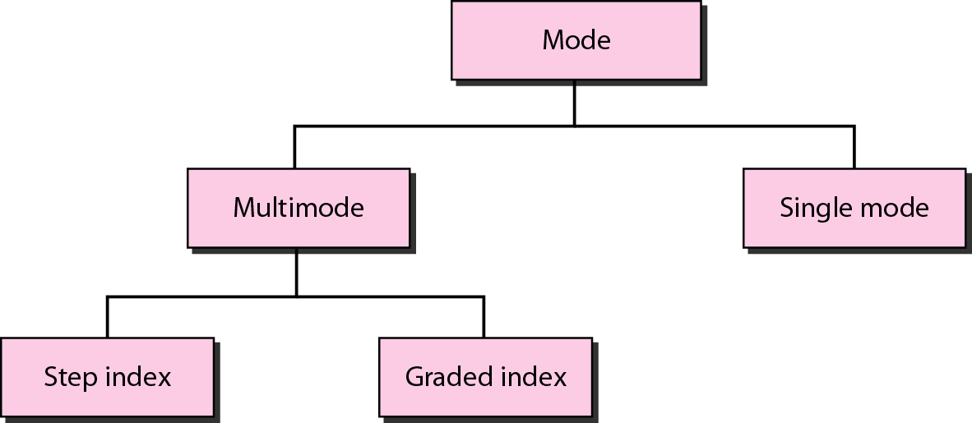
7-1 GUIDED MEDIA
Fiber-Optic Cable Propagation Modes
When signal goes from one point to another there are need for propagation modes.
Figure 7.12 Propagation modes

Slide 33
7-1 GUIDED MEDIA
Fiber-Optic Cable Propagation Modes (cont.)
Multimode:
Multiple beams from a light source move through the core in different paths.
How these beams move within the cable depends on the structure of the core
Multimode step-index fiber:
Density of the core remains constant from the center to the edges.
A beam of light moves through this constant density in a straight line until it reaches the interface of the core and the cladding.
At the interface, there is an abrupt change due to a lower density; this alters the angle of the beam's motion.
The term step index refers to the suddenness of this change, which contributes to the distortion of the signal as it passes through the fiber.

Slide 34
7-1 GUIDED MEDIA
Fiber-Optic Cable Propagation Modes (cont.)
2. Multimode graded-index fiber:
Decreases distortion of the signal through the cable.
The word index here refers to the index of refraction.
One with varying densities.
Density is highest at the center of the core and decreases gradually to its lowest at the edge.

Slide 35
7-1 GUIDED MEDIA
Fiber-Optic Cable Propagation Modes (cont.)
Single-Mode:
Uses step-index fiber and a highly focused source of light that limits beams to a small range of angles, all close to the horizontal.
The single-mode fiber itself is manufactured with a much smaller diameter than multimode fiber, and with substantially lower density (index of refraction).
The decrease in density results in a critical angle that is close enough to 90° to make the propagation of beams almost horizontal.
In this case, propagation of different beams is almost identical, and delays are negligible.
All the beams arrive at the destination "together" and can be recombined with little distortion to the signal

Slide 36
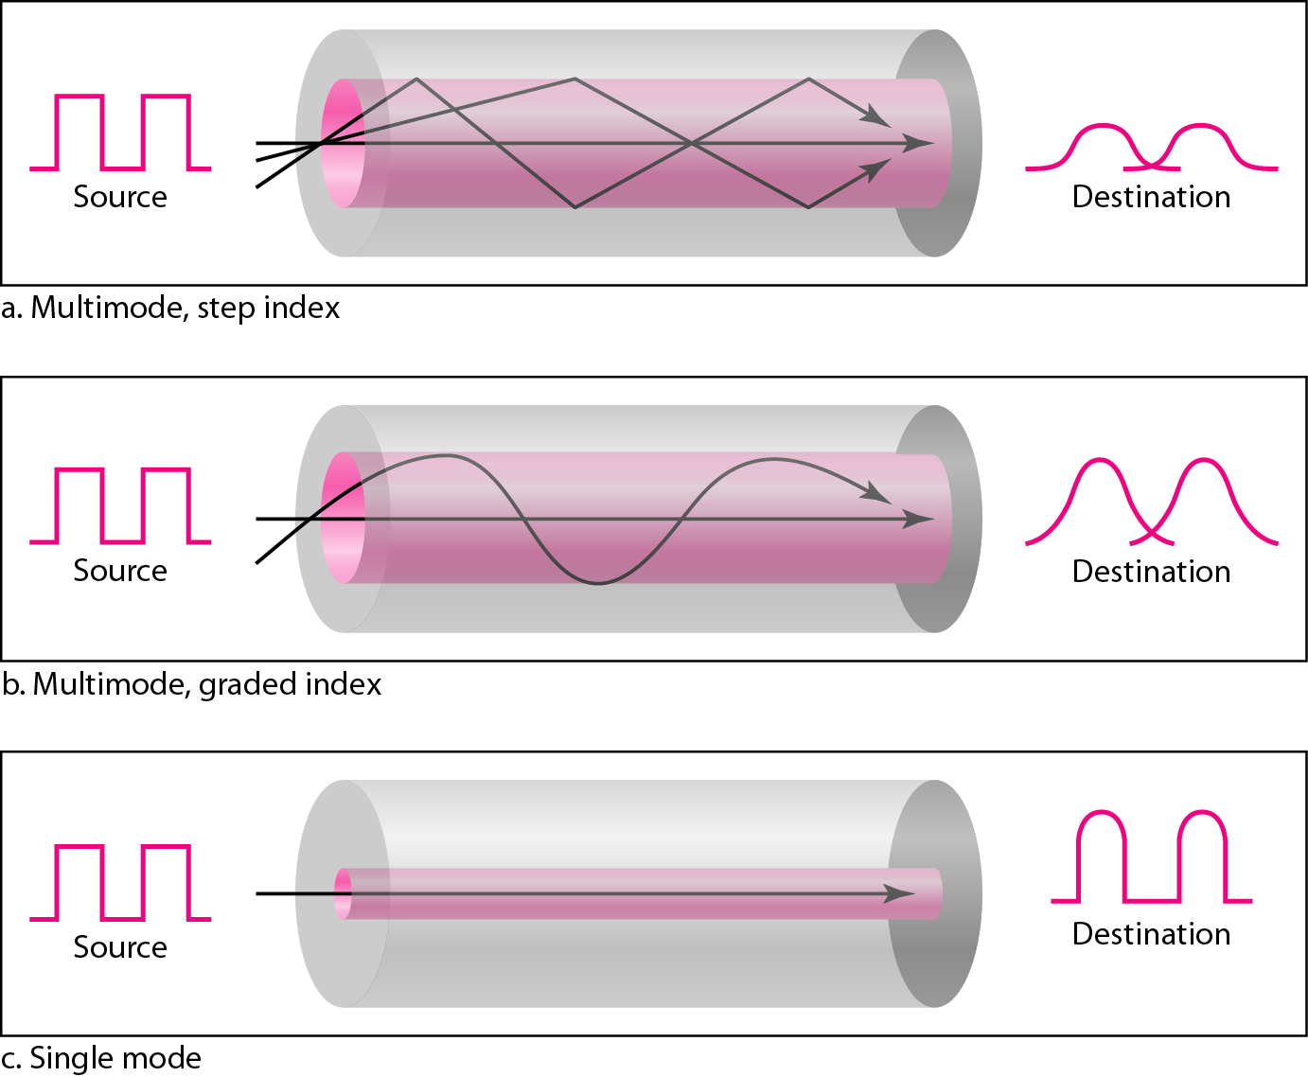
7-1 GUIDED MEDIA
Fiber-Optic Cable Propagation Modes (cont.)
Figure 7.13 Modes

Slide 37
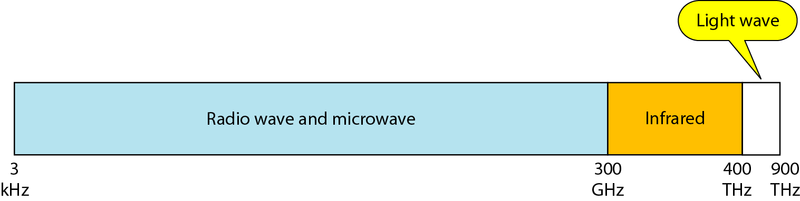
7-2 UNGUIDED MEDIA: WIRELESS
Unguided media transport electromagnetic waves without using a physical conductor.
This type of communication is often referred to as wireless communication.
Signals are normally broadcast through free space and thus are available to anyone who has a device capable of receiving them.
Figure 7.17 Electromagnetic spectrum for wireless communication

Slide 38
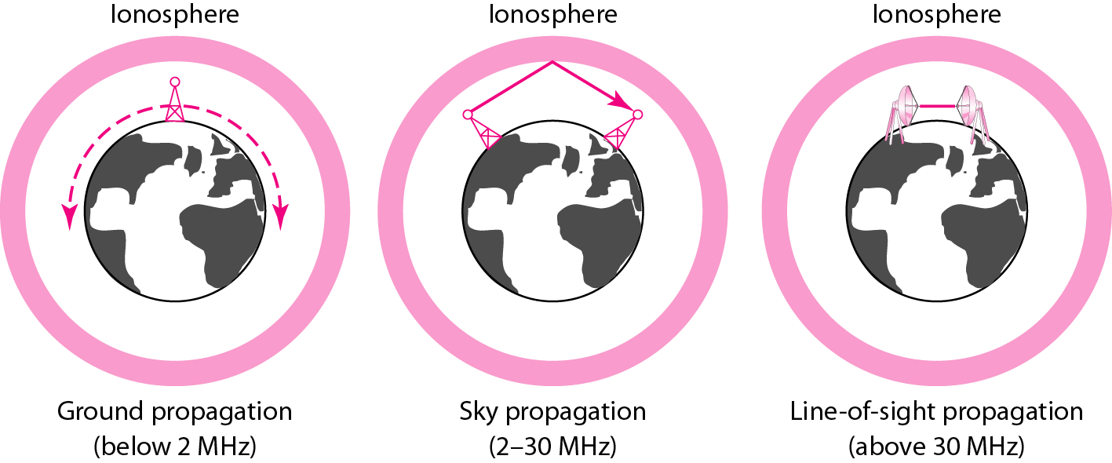
7-2 UNGUIDED MEDIA: WIRELESS
Propagation methods
Unguided signals travels from the source to destination in several ways it is known as propagation.
They are three types.
Figure 7.18 Propagation methods

Slide 39
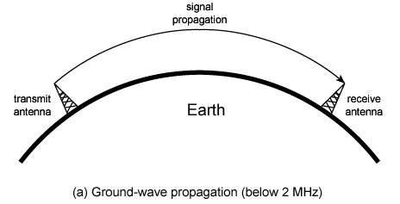
7-2 UNGUIDED MEDIA: WIRELESS
Propagation methods (cont.)
Ground propagation:
Radio waves travel through the lowest portion of the atmosphere, hugging the earth.
These low-frequency signals emanate in all directions from the transmitting antenna and follow the curvature of the planet.
Distance depends on the amount of power in the signal: The greater the power, the greater the distance.

Slide 40
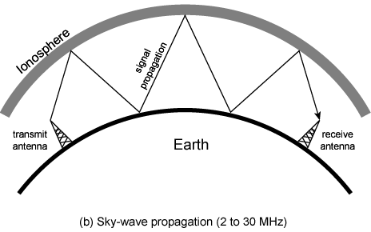
7-2 UNGUIDED MEDIA: WIRELESS
Propagation methods (cont.)
2. Sky propagation
Higher-frequency radio waves radiate upward into the ionosphere (the layer of atmosphere where particles exist as ions) where they are reflected back to earth.
This type of transmission allows for greater distances with lower output power.

Slide 41
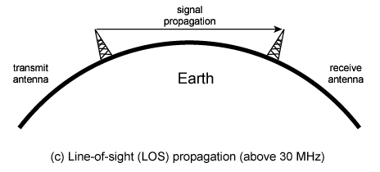
7-2 UNGUIDED MEDIA: WIRELESS
Propagation methods (cont.)
3. Line-of-Sight Propagation
Very high-frequency signals are transmitted in straight lines directly from antenna to antenna.
Antennas must be directional, facing each other, and either tall enough or close enough together not to be affected by the curvature of the earth.
Line-of-sight propagation is tricky because radio transmissions cannot be completely focused.

Slide 42
7-2 UNGUIDED MEDIA: WIRELESS
Propagation methods (cont.)
Bands using propagation method

Slide 43
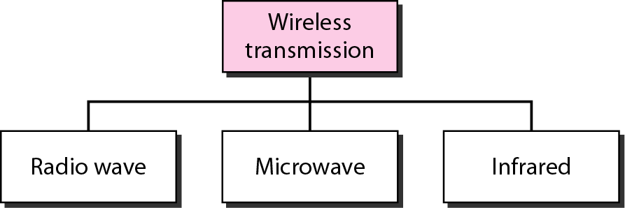
7-2 UNGUIDED MEDIA: WIRELESS
Types of Wireless transmission waves
Figure 7.19 Wireless transmission waves

Slide 44
7-2 UNGUIDED MEDIA: WIRELESS
Unguided Media – Radio Waves
Omnidirectional Antenna – when an antenna transmits radio waves, they are propagated in all directions. sending and receiving antennas do not have to be aligned.
Frequencies between 3 KHz and 1 GHz.
Radio waves, particularly those waves that propagate in the sky mode, can travel long distances.
The radio wave band is relatively narrow, just under 1 GHz, compared to the microwave band.
Radio waves can penetrate buildings easily, so that widely use for indoors & outdoors communication. But disadvantage is we cannot isolate a communication to just inside or outside a building

Slide 45
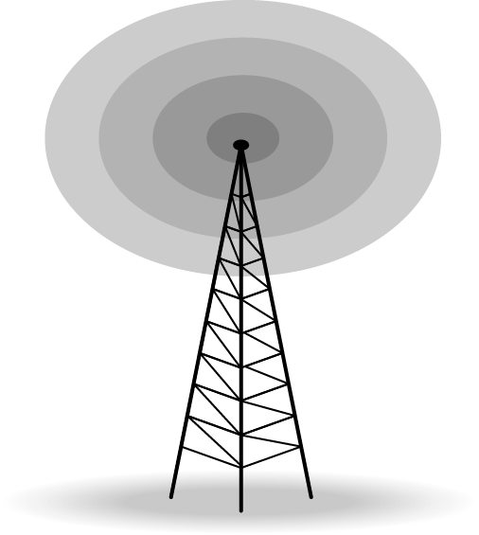
7-2 UNGUIDED MEDIA: WIRELESS
Unguided Media – Radio Waves (cont.)
Omnidirectional Antenna –
Radio waves use omnidirectional antennas that send out signals in all directions.
Based on the wavelength, strength, and the purpose of transmission, we can have several types of antennas
Applications –
Omnidirectional characteristics of radio waves make them useful for multicasting,
AM and FM radio, television, maritime radio, cordless phones, and paging are examples of multicasting.
Figure 7.20 Omnidirectional antenna

Slide 46
7-2 UNGUIDED MEDIA: WIRELESS
Unguided Media – Microwaves
Electromagnetic waves having frequencies between I and 300 GHz are called microwaves.
Microwaves are unidirectional
When an antenna transmits microwave waves, they can be narrowly focused. This means that the sending and receiving antennas need to be aligned.
Microwave propagation is line-of-sight.
Very high-frequency microwaves cannot penetrate walls. This characteristic can be a disadvantage if receivers are inside buildings.
The microwave band is relatively wide, almost 299 GHz.

Slide 47
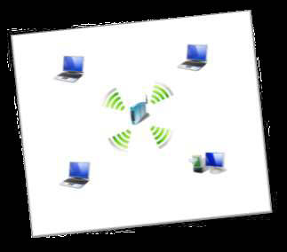

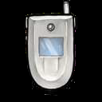

7-2 UNGUIDED MEDIA: WIRELESS
Unguided Media – Microwaves (cont.)
There are two types of micro waves data communication system : terrestrial and satellite
Micro waves are widely used for one to one communication between sender and receiver
example: cellular phone, satellite networks and in wireless LANs(wifi), WiMAX, GPS

Slide 48
7-2 UNGUIDED MEDIA: WIRELESS
Unidirectional Antenna
Two types of antennas are used for microwave communications
Parabolic dish antenna–
Based on the geometry of a parabola:
Every line parallel to the line of symmetry (line of sight) reflects off the curve at angles such that all the lines intersect in a common point called the focus.
The parabolic dish works as a funnel, catching a wide range of waves and directing them to a common point.
Horn antenna –
Looks like a gigantic scoop.
Outgoing transmissions are broadcast up a stem (resembling a handle) and deflected outward in a series of narrow parallel beams by the curved head.
Received transmissions are collected by the scooped shape of the horn.

Slide 49
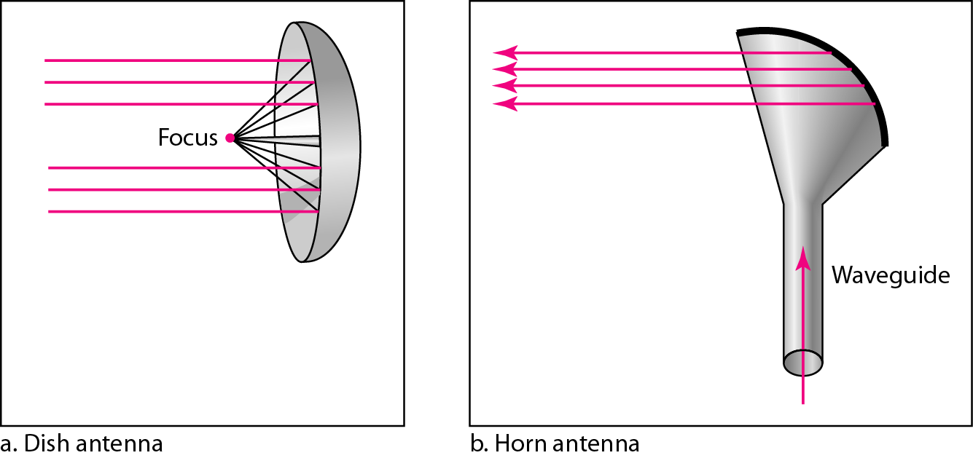
7-2 UNGUIDED MEDIA: WIRELESS
Unidirectional Antenna

Slide 50
7-2 UNGUIDED MEDIA: WIRELESS
Unguided Media – Infrared
Frequencies between 300 GHz to 400 THz.
Used for short-range communication
Cannot penetrate walls
Example: Night Vision Camera, Remote control, File sharing between two phones, Communication between a PC and peripheral device,

